Slide 1
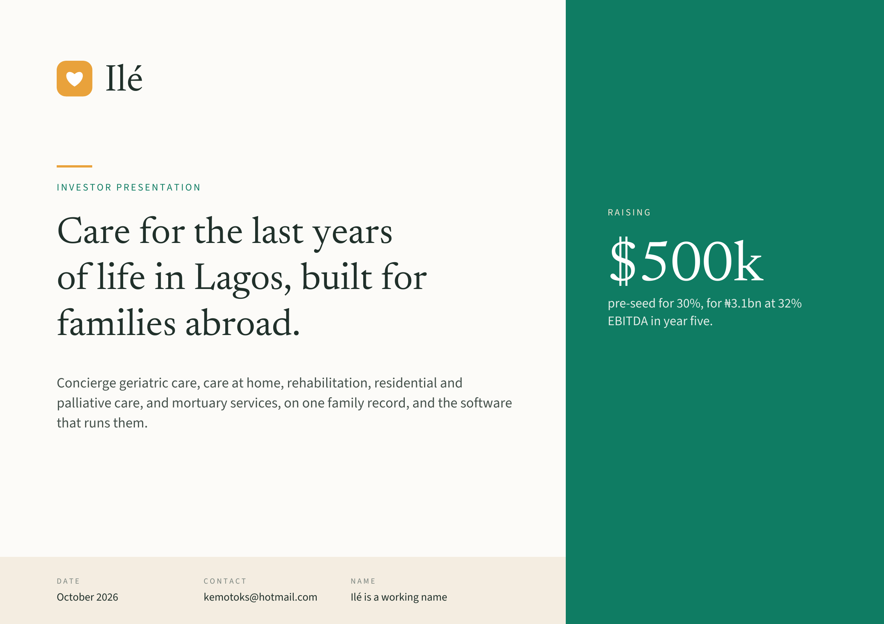
Notes:
Ilé
INVESTOR PRESENTATION
RAISING
Care for the last years
of life in Lagos, built for $500k
pre-seed for 30%, for ₦3.1bn at 32%
families abroad. EBITDA in year five.
Concierge geriatric care, care at home, rehabilitation, residential and
palliative care, and mortuary services, on one family record, and the software
that runs them.
DATE CONTACT NAME
October 2026 kemotoks@hotmail.com Ilé is a working name

Slide 2
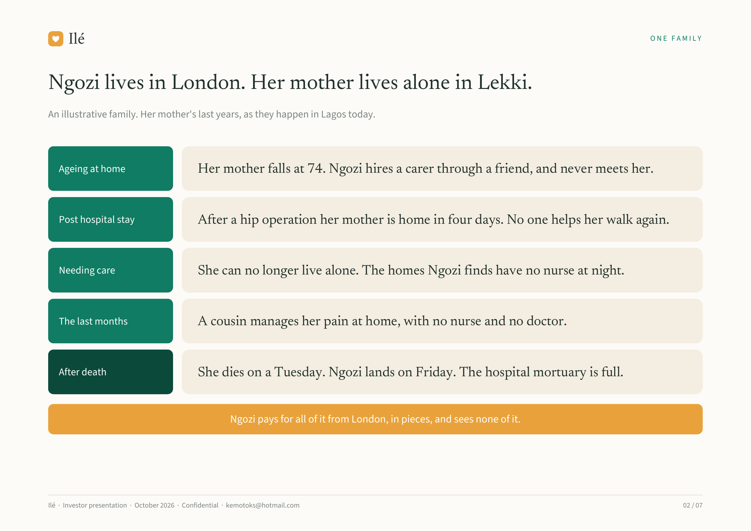
Notes:
Ilé ONE FAMILY
Ngozi lives in London. Her mother lives alone in Lekki.
An illustrative family. Her mother's last years, as they happen in Lagos today.
Ageing at home Her mother falls at 74. Ngozi hires a carer through a friend, and never meets her.
Post hospital stay After a hip operation her mother is home in four days. No one helps her walk again.
Needing care She can no longer live alone. The homes Ngozi finds have no nurse at night.
The last months A cousin manages her pain at home, with no nurse and no doctor.
After death She dies on a Tuesday. Ngozi lands on Friday. The hospital mortuary is full.
Ngozi pays for all of it from London, in pieces, and sees none of it.
Ilé · Investor presentation · October 2026 · Confidential · kemotoks@hotmail.com 02 / 07

Slide 3
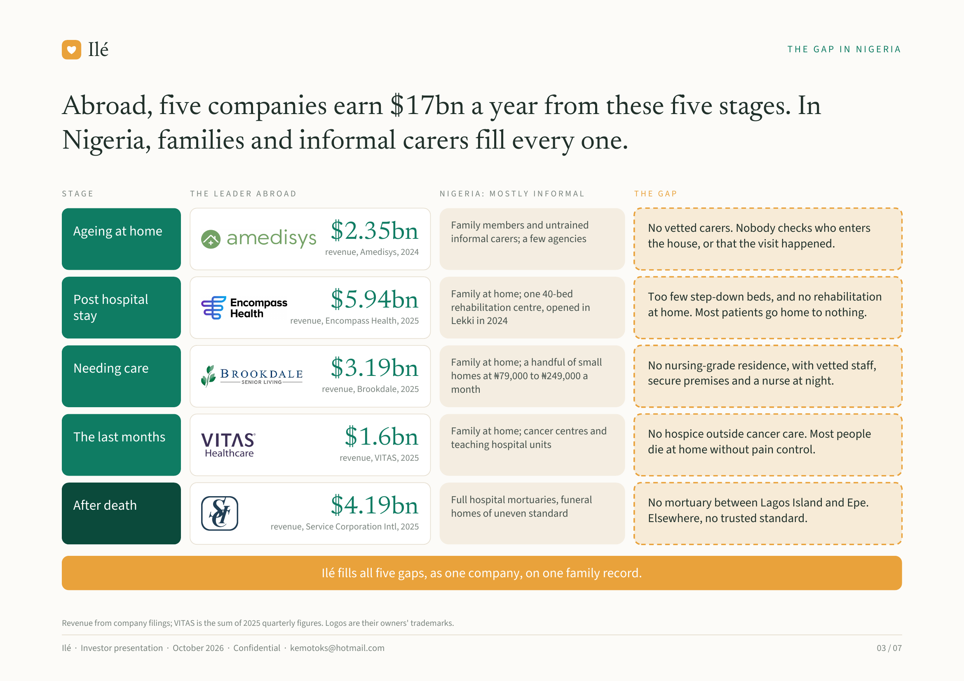
Notes:
Ilé THE GAP IN NIGERIA
Abroad, five companies earn $17bn a year from these five stages. In
Nigeria, families and informal carers fill every one.
STAGE THE LEADER ABROAD NIGERIA: MOSTLY INFORMAL THE GAP
Family members and untrained No vetted carers. Nobody checks who enters
Ageing at home $2.35bn informal carers; a few agencies
the house, or that the visit happened.
revenue, Amedisys, 2024
Family at home; one 40-bed Too few step-down beds, and no rehabilitation
Post hospital $5.94bn rehabilitation centre, opened in
at home. Most patients go home to nothing.
stay revenue, Encompass Health, 2025 Lekki in 2024
Family at home; a handful of small No nursing-grade residence, with vetted staff,
Needing care $3.19bn homes at ₦79,000 to ₦249,000 a
secure premises and a nurse at night.
revenue, Brookdale, 2025 month
Family at home; cancer centres and No hospice outside cancer care. Most people
The last months $1.6bn teaching hospital units
die at home without pain control.
revenue, VITAS, 2025
Full hospital mortuaries, funeral No mortuary between Lagos Island and Epe.
After death $4.19bn homes of uneven standard
Elsewhere, no trusted standard.
revenue, Service Corporation Intl, 2025
Ilé fills all five gaps, as one company, on one family record.
Revenue from company filings; VITAS is the sum of 2025 quarterly figures. Logos are their owners' trademarks.
Ilé · Investor presentation · October 2026 · Confidential · kemotoks@hotmail.com 03 / 07

Slide 4
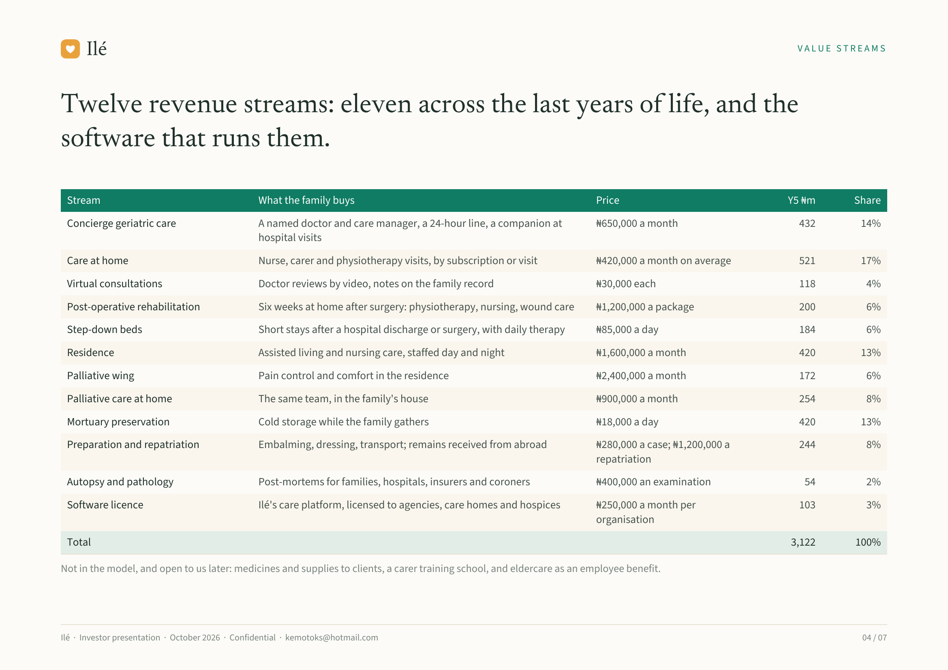
Notes:
Ilé VALUE STREAMS
Twelve revenue streams: eleven across the last years of life, and the
software that runs them.
Stream What the family buys Price Y5 ₦m Share
Concierge geriatric care A named doctor and care manager, a 24-hour line, a companion at ₦650,000 a month 432 14%
hospital visits
Care at home Nurse, carer and physiotherapy visits, by subscription or visit ₦420,000 a month on average 521 17%
Virtual consultations Doctor reviews by video, notes on the family record ₦30,000 each 118 4%
Post-operative rehabilitation Six weeks at home after surgery: physiotherapy, nursing, wound care ₦1,200,000 a package 200 6%
Step-down beds Short stays after a hospital discharge or surgery, with daily therapy ₦85,000 a day 184 6%
Residence Assisted living and nursing care, staffed day and night ₦1,600,000 a month 420 13%
Palliative wing Pain control and comfort in the residence ₦2,400,000 a month 172 6%
Palliative care at home The same team, in the family's house ₦900,000 a month 254 8%
Mortuary preservation Cold storage while the family gathers ₦18,000 a day 420 13%
Preparation and repatriation Embalming, dressing, transport; remains received from abroad ₦280,000 a case; ₦1,200,000 a 244 8%
repatriation
Autopsy and pathology Post-mortems for families, hospitals, insurers and coroners ₦400,000 an examination 54 2%
Software licence Ilé's care platform, licensed to agencies, care homes and hospices ₦250,000 a month per 103 3%
organisation
Total 3,122 100%
Not in the model, and open to us later: medicines and supplies to clients, a carer training school, and eldercare as an employee benefit.
Ilé · Investor presentation · October 2026 · Confidential · kemotoks@hotmail.com 04 / 07

Slide 5
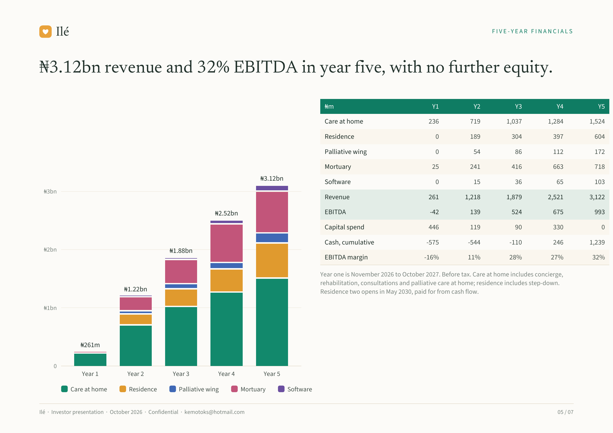
Notes:
Ilé FIVE-YEAR FINANCIALS
₦3.12bn revenue and 32% EBITDA in year five, with no further equity.
₦m Y1 Y2 Y3 Y4 Y5
Care at home 236 719 1,037 1,284 1,524
Residence 0 189 304 397 604
Palliative wing 0 54 86 112 172
Mortuary 25 241 416 663 718
₦3.12bn Software 0 15 36 65 103
₦3bn
Revenue 261 1,218 1,879 2,521 3,122
₦2.52bn EBITDA -42 139 524 675 993
Capital spend 446 119 90 330 0
Cash, cumulative -575 -544 -110 246 1,239
₦2bn ₦1.88bn
EBITDA margin -16% 11% 28% 27% 32%
Year one is November 2026 to October 2027. Before tax. Care at home includes concierge,
rehabilitation, consultations and palliative care at home; residence includes step-down.
₦1.22bn Residence two opens in May 2030, paid for from cash flow.
₦1bn
₦261m
0
Year 1 Year 2 Year 3 Year 4 Year 5
Care at home Residence Palliative wing Mortuary Software
Ilé · Investor presentation · October 2026 · Confidential · kemotoks@hotmail.com 05 / 07

Slide 6
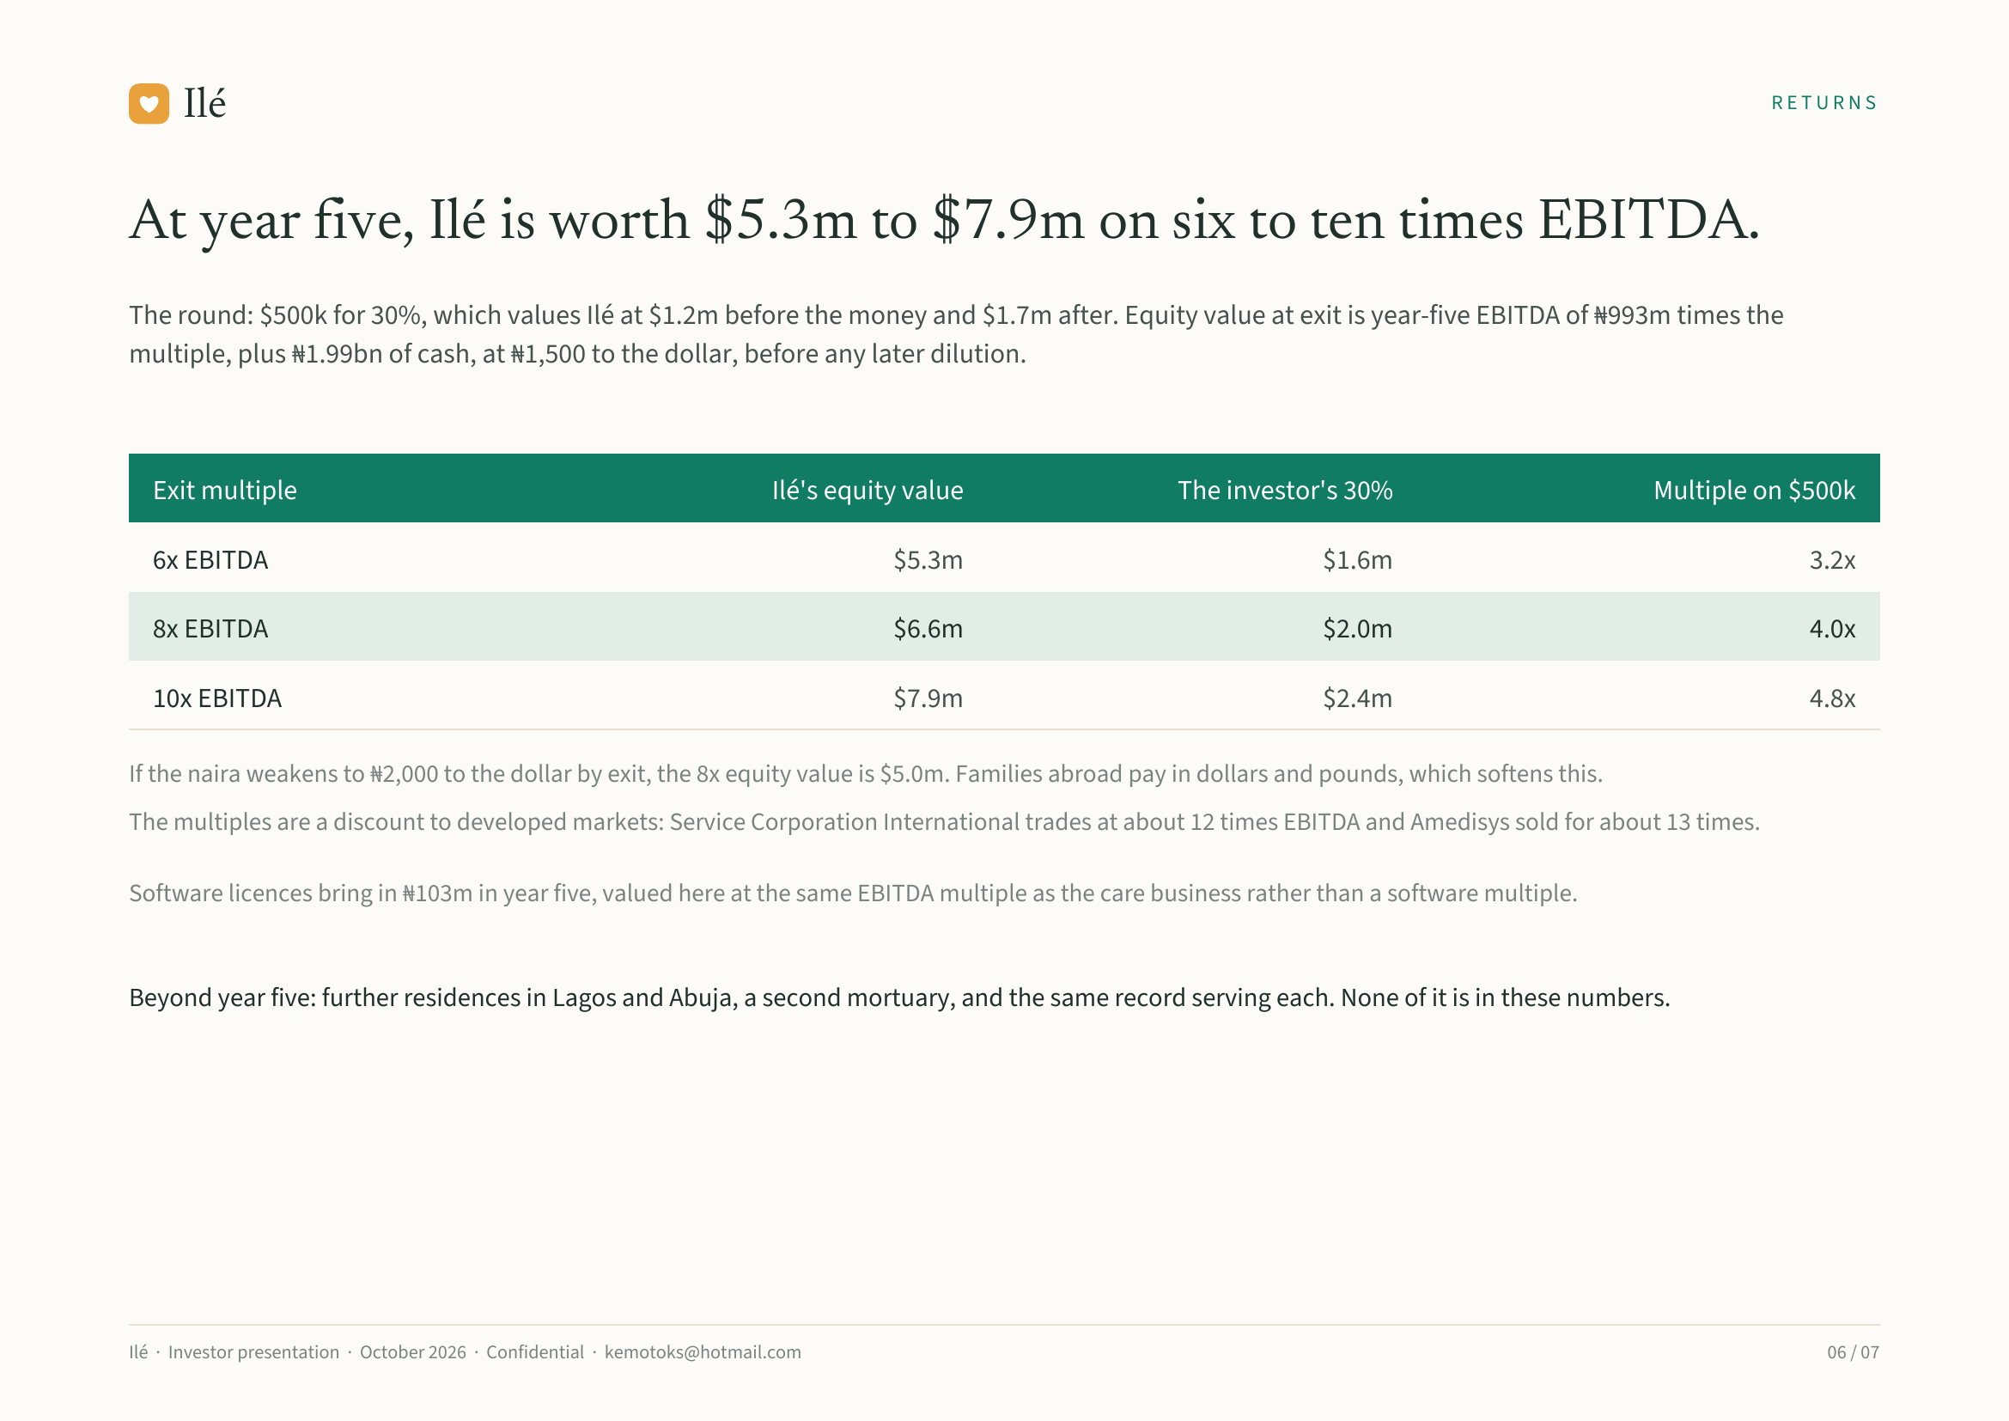
Notes:
Ilé RETURNS
At year five, Ilé is worth $5.3m to $7.9m on six to ten times EBITDA.
The round: $500k for 30%, which values Ilé at $1.2m before the money and $1.7m after. Equity value at exit is year-five EBITDA of ₦993m times the
multiple, plus ₦1.99bn of cash, at ₦1,500 to the dollar, before any later dilution.
Exit multiple Ilé's equity value The investor's 30% Multiple on $500k
6x EBITDA $5.3m $1.6m 3.2x
8x EBITDA $6.6m $2.0m 4.0x
10x EBITDA $7.9m $2.4m 4.8x
If the naira weakens to ₦2,000 to the dollar by exit, the 8x equity value is $5.0m. Families abroad pay in dollars and pounds, which softens this.
The multiples are a discount to developed markets: Service Corporation International trades at about 12 times EBITDA and Amedisys sold for about 13 times.
Software licences bring in ₦103m in year five, valued here at the same EBITDA multiple as the care business rather than a software multiple.
Beyond year five: further residences in Lagos and Abuja, a second mortuary, and the same record serving each. None of it is in these numbers.
Ilé · Investor presentation · October 2026 · Confidential · kemotoks@hotmail.com 06 / 07

Slide 7
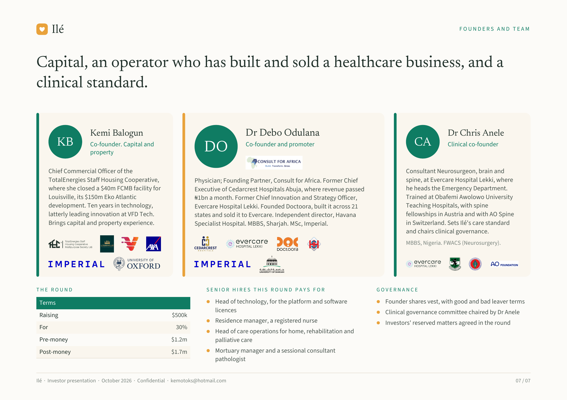
Notes:
Ilé FOUNDERS AND TEAM
Capital, an operator who has built and sold a healthcare business, and a
clinical standard.
Kemi Balogun Dr Debo Odulana Dr Chris Anele
KB Co-founder. Capital and
DO Co-founder and promoter CA Clinical co-founder
property
Chief Commercial Officer of the Consultant Neurosurgeon, brain and
TotalEnergies Staff Housing Cooperative, Physician; Founding Partner, Consult for Africa. Former Chief spine, at Evercare Hospital Lekki, where
where she closed a $40m FCMB facility for Executive of Cedarcrest Hospitals Abuja, where revenue passed he heads the Emergency Department.
Louisville, its $150m Eko Atlantic ₦1bn a month. Former Chief Innovation and Strategy Officer, Trained at Obafemi Awolowo University
development. Ten years in technology, Evercare Hospital Lekki. Founded Doctoora, built it across 21 Teaching Hospitals, with spine
latterly leading innovation at VFD Tech. states and sold it to Evercare. Independent director, Havana fellowships in Austria and with AO Spine
Brings capital and property experience. Specialist Hospital. MBBS, Sharjah. MSc, Imperial. in Switzerland. Sets Ilé's care standard
and chairs clinical governance.
MBBS, Nigeria. FWACS (Neurosurgery).
THE ROUND SENIOR HIRES THIS ROUND PAYS FOR GOVERNANCE
Terms Head of technology, for the platform and software Founder shares vest, with good and bad leaver terms
licences Clinical governance committee chaired by Dr Anele
Raising $500k
Residence manager, a registered nurse Investors' reserved matters agreed in the round
For 30%
Head of care operations for home, rehabilitation and
Pre-money $1.2m palliative care
Post-money $1.7m Mortuary manager and a sessional consultant
pathologist
Ilé · Investor presentation · October 2026 · Confidential · kemotoks@hotmail.com 07 / 07

